Slide 1
Selecting Talent
Session 4/10
Part II

Slide 2
Assessment Centres

Slide 3
Assessment Centres
“consists of a small group of participants who undertake a series of tests and exercises under observation, with a view to the assessment of their skills and competencies, their suitability for particular roles and their potential for development” (Fowler, 1992).
Features of an assessment centre:
A variety of individual and group exercises are used (presentations, role-plays, group discussions, interviews and psychometric testing) aiming to assess participants’ performance in a range of observable skills and competencies (e.g. leadership, teamwork)
Multiple assessors are used (the ratio is usually 1 assessor per 2 candidates). These are typically operational managers above the target position, human resource managers, psychologists, and external consultants.
Selection (promotion) decisions are based on pooled information from assessors and techniques
Job analysis is used to identify the behaviours and characteristics to be measured by the assessment centre.

Slide 4
Validity of Assessment Centres
Bray and Grant (1966) reported that assessment Centre ratings predicted salary progress
Bray and Campbell (1968) found a correlation of .51 between assessment centre ratings and subsequent job performance ratings
Borman (1982) found a correlation of .48 between assessment centre ratings and performance in training.

Slide 5
References

Slide 6
References
These are used to obtain additional information about candidates from third parties such as previous employers, academic tutors, colleagues or acquaintances.
Usefulness:
  Important to obtain factual information such as the nature of previous job, time in employment, reason for leaving, salary, academic achievement;
  Less useful to obtain opinions about character and suitability of candidates (everybody has a couple of good friends!)

Slide 7
Selection Interviews

Slide 8
Aims of the selection interview
An interview gives you the chance to evaluate the candidate’s…
Knowledge – what the individual needs to know to carry out the role.
Skills and abilities – what the individual has to be able to do to carry out the role
Behavioural competencies – the types of behavior required for successful performance of the role
Qualifications and training – the professional, technical or academic qualifications required or the training that the candidate should have undertaken
Experience – the types of achievements and activities that would be likely to predict success
Special requirements – travelling, unsocial hours, mobility, etc.
Are they competent?
Are they motivated?
Do they fit the organization?

Slide 9
Preparing for an interview
What are the criteria to be used in selecting the candidate? (knowledge, skill and competency requirements; experience, qualifications and training that will satisfy those requirements as set out in the person specification)
What more do I need to find out at the interview to ensure that the candidate meets the essential selection criteria?
How am I going to structure the interview in terms of the questions I need to ask and the sequence in which these questions are covered? These may be quite detailed if a highly structured approach is being adopted.

Slide 10
Structured interviews
Features of structured interviews
  The interaction is standardized as much as possible
  All candidates are asked the same series of questions
  Replies are rated by the interviewer on preformatted rating scales
  Dimensions for rating are derived from critical aspects of on-the-job behavior

Slide 11
Structured interviews
Why structured interviews?
  Unstructured interviews are (more) subjective, (more) prone to interviewer bias, and therefore less reliable predictors of future performance
  You can use multiple interviewers and several interview stages to control for subjectivity

Slide 12
Types of Selection Interview
Biographical interview
  Focus on candidate´s work experiences (a chronological approach is usually adopted)
  More attention is paid to more recent work experiences

Slide 13
Types of Selection Interview
Behavioural interview (or experienced-based interview)
  The interviewer poses questions or asks for descriptions of how the candidate behaved in specific situations
  The behaviors probed are aligned to a behavioral competency that has been defined as a requirement in the person specification (e.g. work under pressure; interpersonal relations)
  “Can you give me an example of when you have had to deal with a difficult person?”
“Have you ever felt under tremendous pressure to achieve a result? If so, how did you deal with it?”

Slide 14
Behavioural interview (or experienced-based interview)
  Advantage
  Past performance is a relatively good indicator of future performance in similar circumstances
  Disadvantage
  Makes comparison between candidates more difficult as they each discuss their own different experiences
  Other
  Allows the interviewer more freedom to direct the line of questionning to explore interviewees’ experience (advantage/disadvangage?)

Slide 15
  Types of Selection Interview
  Situational interview
  The focus is on a number of situations or incidents in which behavior can be regarded as being indicative of subsequent performance
  “What would you do if you had to deal with a difficult person?”

Slide 16
  Situational interview
  Advantages
  All interviewees answer the same question which makes comparison easier
  Allows respondents who have not had direct experience relevant to a particular dimension to provide an answer
  Disadvantages
  How people claim they would behave is not necessarily how they actually would behave in a specific situation.

Slide 17
Validity of selection interviews
Mayfield (1964)
Structured interviews have higher interrater reliability than unstructured interviews
Wright (1969)
Structured interviews are more reliable than unstructured interviews
Dunnette, Arvey and Arnold (1971)
The use of interviews in selection is associated with supervisor ratings of performance

Slide 18
Validity of selection interviews
Hunter & Hunter (1984)
The use of interviews in selection is associated with supervisor ratings of performance, job tenure and promotion rates
Conway, Jako, and Goodman (1995)
The average reliability of highly structured individual interviews was 0.59, while the reliability of unstructured individual interviews was 0.37
Pulakos & Schmitt (1995)
Their study showed that experience-based interview questions yielded higher levels of validity than the situational questions, i.e., that past behavior is a better predictor of future performance than individual accounts about how they would behave in specific scenarios.
Kutcher et al (1993)
  Their experimental study showed that more structured interviews mitigate bias against overweight candidates as interviewers focus more on job-related criteria

Slide 19
Validity of Selection Methods

Slide 20
Overall validity of selection methods
There is a choice to be made between selection methods. The most important criterion is the predictive validity of the method or combination of methods.
In this case, predictive validity refers to the extent to which one can be confident that a given method will predict employee performance (perfect validity is 1.0; no validity is 0.0)
Schmidt and Hunter’s (1998) meta-analysis showed the following predictive validity coefficients:
Method or combination of methods | Correlation with job performance
Intelligence tests and structured interviews | .63
Intelligence tests and unstructured interviews | .55
Assessment centres and structured interviews | .53
Intelligence tests only | .51
Structured interviews only | .51
Unstructured interviews only | .38
Assessment centres only | .37
Personality assessments only | .37

Slide 21
Overall validity of selection methods
Schmith, Ho & Schaffer (2003) have updated Schmidt and Hunter’s (1998) meta-analysis
Analysed the validity of 31 procedures for predicting job performance
Analysed the validity of paired combinations of general mental ability (GMA) and other selection procedures

Slide 22
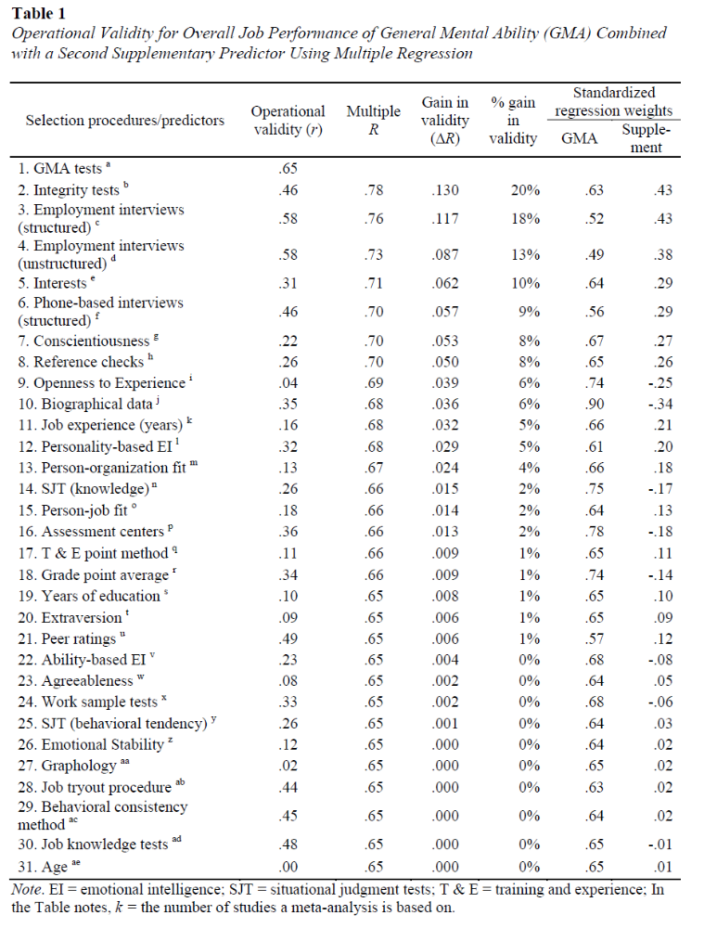
Overall validity of selection methods
GMA tests present the highest validity to predict job performance (because of its association with job-related knowledge seeking behaviours)
GMA + Integrity tests (capturing conscientiousness) & GMA + Structured Interviews are the two combinations with the highest validity for predicting job performance

Slide 23
Selection Bias

Slide 24
Bias in decision-making
“similar to me effect”, where the interviewers enhance the ratings of those who look like themselves, respond in a similar way, or appear to have equivalent experiences
“halo effect”, where one aspect of the candidate’s qualities (most commonly physical attractiveness) influences all other aspects and so boosts their overall rating
“horns effect”, where over-attention to some negative aspect reduces a candidate’s overall rating

Slide 25
Bias in selection interviews
Mayfield (1964)
Individual interviewers are often inconsistent in their interpretation of data (judgement biases, tendency to make decisions early on in unstructured interviews)
Wright (1969)
Interview decisions are often based on behavioural and verbal cues
The rapport between interviewer and interviewee is an important variable that influences the effectiveness of the interview
Schmitt (1976)
Interview decisions are strongly affected by factors such as the physical appearance of candidates and the race of the interviewer/interviewee

Slide 26
Bias in selection interviews
Pingatore, Dugoni, Tindale, & Spring, 1994
Moderately obese applicants (especially female applicants) were much less likely to be recommended for employment, even controlling for job qualifications.
Dougherty, Turban, & Callender, 1994
First impressions - on average, interviewers reach final decisions about applicants after only 4 min of a 30-min interview

Slide 27
Bias is (oftentimes) unconscious
Similarity attraction and social identity theories tells us that we tend to gravitate and feel more comfortable with people who look, think and act like us.
These preferences, prejudices and ‘biases’ are deeply embedded within us at an unconscious level.
Unconscious bias is one of the main factors explaining a homogenous work environment and therefore acts against workplace diversity.

Slide 28
Study on the career success of recent graduates
Salary |  |  | Sig.
 |  | β
 | Degree classification | -,143 | ,177
 | Age | ,068 | ,482
 | Ethnic background (0= white) | -,275 | ,009
 | Gender (0 = Women) | -,197 | ,051
 | Marital status (0 = Single) | -,078 | ,476
 | Dependent children (0 = No) | -,106 | ,329
 | Family income | ,091 | ,386
 | Father's education | -,058 | ,603
 | Mother's education | ,236 | ,049

Slide 29
References
Barrick, M. R., Dustin, S. L., Giluk, T. L., Stewart, G. L., Shaffer, J. A., & Swider, B. W. (2012). Candidate characteristics driving initial impressions during rapport building: Implications for employment interview validity. Journal of Occupational and Organizational Psychology, 85(2), 330-352.
Connelly, B. L., Certo, S. T., Ireland, R. D., & Reutzel, C. R. (2011). Signalling theory: A review and assessment. Journal of Management, 37(1), 39-67.
Conway, J. M., Jako, R. A., & Goodman, D. F. (1995). A meta-analysis of interrater and internal consistency reliability of selection interviews. Journal of applied psychology, 80(5), 565.
De Cooman, R., De Gieter, S., Pepermans, R., Hermans, S., Du Bois, C., Caers, R., & Jegers, M. (2009). Person–organization fit: Testing socialization and attraction–selection–attrition hypotheses. Journal of Vocational Behavior, 74(1), 102-107.
Dougherty, T. W., Turban, D. B., & Callender, J. C. (1994). Confirming first impressions in the employment interview: A field study of interviewer behavior. Journal of Applied Psychology, 79, 659-665.
Dunnette, M. D. (1972). Validity study results for jobs relevant to the petroleum refining industry.
Gosling, S. D., Rentfrow, P. J., & Swann Jr, W. B. (2003). A very brief measure of the Big-Five personality domains. Journal of Research in personality, 37(6), 504-528.
Hunter, J & Hunter, R (1984). The validity and utility of alternative predictors of job performance. Psychological Bulletin, 96, 72-98.
Judge, T. A., Cable, D. M., & Higgins, C. A. (2001). The employment interview: A review of recent research and recommendations for future research. Human Resource Management Review, 10(4), 383-406.
Mayfield, E. C. (1964). The selection interview: A re-evaluation of published research. Personnel psychology.
Pulakos, E. D., & Schmitt, N. (1995). Experience‐based and situational interview questions: Studies of validity. Personnel Psychology, 48(2), 289-308.
Pingatore, R., Dugoni, B. L., Tindale, R. S., & Spring, B. (1994). Bias against overweight job applicants in a simulated employment interview. Journal of Applied Psychology, 79, 909-917.
Sackett, P. R., Dahlke, J. A., Shewach, O. R., & Kuncel, N. R. (2017). Effects of predictor weighting methods on incremental validity. Journal of Applied Psychology, 102(10), 1421.
Schmidt, F. L., & Hunter, J. E. (1998). The validity and utility of selection methods in personnel psychology: Practical and theoretical implications of 85 years of research findings. Psychological bulletin, 124(2), 262.
Schneider, B., Smith, D. B., & Goldstein, H. W. (2000). Attraction–selection–attrition: Toward a person–environment psychology of organizations. Lawrence Erlbaum Associates Publishers.
Wright, O. R. (1969). Summary of research on the selection interview since 1964. Personnel Psychology, 22(4), 391-413.

